Slide 1
TRANSFORMATION OF EQUATIONS
CHAPTER 4

Slide 2
INTRODUCTION
Transformation of equations
To transform any equations know the relation between the roots and the required roots and apply the transformation
for ex:to get the equation which has roots reciprocal of the given equation replace x with 1/x.

Slide 3
Transformation of equations 1
1. Transformation of an equation into another equation whose roots are
reciprocals of the roots of a given equation we replace x→1/x
2. Transformation of an equation into another equation whose roots are negative of the roots of a given equation we replace x→−x
3. Transformation of an equation into another equation whose roots are square of the roots of a given equation we replace x→x
4.Transformation of an equation into another equation whose roots are cubes of the roots of a given equation we replace x→3x

Slide 4
Eliminating terms
Given a term to eliminate from the given polynomial a relation is to be developed so that the term gets eliminated ,once the relation is ready ,use transformation to get that term eliminated

Slide 5
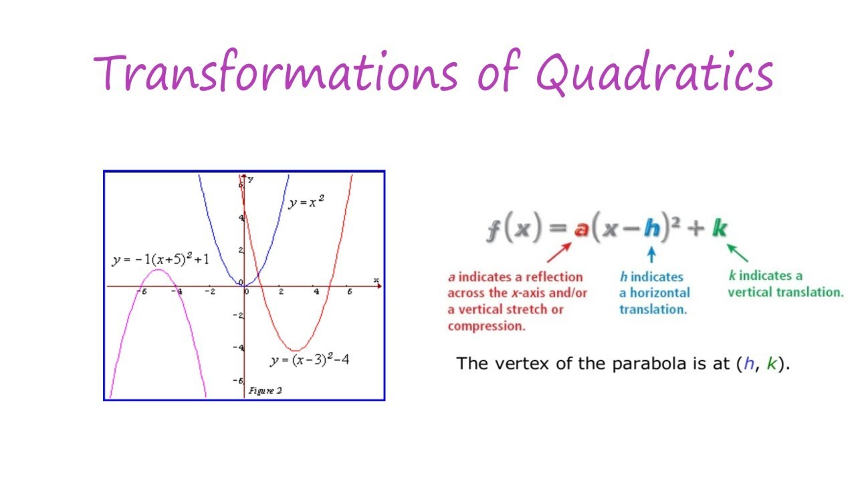

Slide 6
Transformation of an equation into another equation whose roots are reciprocals of the roots of a given equation
Let f(x)= a₀x^{n} +a₁x^{n-1} +a₂x^{n-2} +...+a_{n-1}x + a_{n} =0 be the given equation. Then, y=1/x
or, x=1/y
Putting x=1/y in the equation , we get
a₀/y^{n} +a_{1/}y^{n-1} +a_{2/}y^{n-2} +...+a_{n-1/}y + a_{n} =0
or, a_{n}y^{n} +a_{n-1}y^{n-1} +a_{n-2}y^{n-2} +...+a₁y + a₀ =0
This is the required equation.
Conclusion: To obtain an equation whose roots are reciprocals of the roots of a given equation, replace x by 1/x in the given equation.

Slide 7
Illustrative example:
Find the condition that the roots of the equation x³ -px² +qx -r =0 be in H.P
Solution:
The equation whose roots are reciprocals of the roots of the given equation is given by
1/x³ -p/x² +q/x -r =0
or, rx³ -qx² +px -1 =0 .....1
Since the roots of the given equation are in H.P , the roots of this equation are in A.P.
Let the roots be a-d, a, a+d
Then,
(a-d) + a + (a+d) = -(-q/r)
or, 3a=q/r
or, a=q/3r
Since a is a root of 1., so r a³ -qa² +pa -1 =0
or, r(q/3r)³ -q(q/3r)² +p(q/3r) -1 =0
or, (q³ /27r²⁾ -(q³ /9r²⁾ +(pq/3r) -1=0
or, q³ -3q² +9pqr -27r² =0
or, 27r² -9pqr +2q³
This is the required condition.

Slide 8
2. Transformation of an equation into another equation whose roots are negative of the roots of a given equation
Let f(x)= a₀x^{n} +a₁x^{n-1} +a₂x^{n-2} +...+a_{n-1}x + a_{n} =0 be the given equation.
Let x be a root of the given equation and y be a root of the transformed equation.
Then,
y=-x
or, x=-y
Thus the transformed equation is obtained by putting x=-y in f(x)=0.
So the transformed equation is f(-y)=0

Slide 9
Illustrative example:
Find the equation whose roots are negative of the roots of the equation
x3 -3x2 +x+1=0
Solution:
Putting x=-x in the equation, we get
-x3 -3x2 -x+1=0
or,x3 +3x2 +x-1=0

Slide 10
3. Transformation of an equation into another equation whose roots are square of the roots of a given equation
Let x be a root of the given equation and y be the root of the transformed equation.
Then,
y=x²
^{or, x= √y}

Slide 11
Illustrative example:
Form an equation whose roots are square of the roots of the equation :
x3 -2x2 +3x +1 =0
Solution:
Replace x by √x in the given equation , we get
(√x)3 -2x +3√x +1 =0
or, x√x -2x +3√x +1 =0
or, √x(x+3) = 2x-1
or, x(x+3)2 = (2x-1)2
or, x(x2 +6x +9) = (4x2 +1-4x)
or, x3 + 6x2 +9x = 4x2 +1-4x
or, x3 + 6x2 +9x -4x2 -1+4x =0
or, x3 + 2x2 +13x -1 =0

Slide 12
4.Transformation of an equation into another equation whose roots are cubes of the roots of a given equation
Let x be a root of the given equation and y be the root of the transformed equation.
Then,
y=x³
^{or, x=y1/3}
Thus, an equation whose roots are cubes of the roots of a given equation is obtained by
^{replacing x by x1/3} in the given equation.

Slide 13
Illustrative example:
Form an equation whose roots are cubes of the roots of equation
ax³ + bx² +cx +d =0
solution:
Replacing x by x^{1/3} in the given equation, we get
a(x^{1/3})³ + b(x^{1/3})² +c(x^{1/3}) +d =0
or, ax +d = -(bx^{2/3} +cx^{1/3} )
or, (ax+d)³ = -(bx^{2/3} +cx^{1/3} )³
^{or, a3} x³ + 3a² dx² +3ad² x + d³ = -(b³ x² +c³ x -3bcx(ax+d))
or, a³ x³ + x² (3a² d -3abc +b³ ) + x(3ad² -3bcd +c³ ) +d³ =0
This is the required equation.

